Slide 1

Extension Disaster/Emergency Preparation Training
East Kentucky Disaster Assessment – Lessons for the future
Daniel Kahl, University of Kentucky Extension, CEDIK

Slide 2
Presentation overview
11:00 Brief introduction and overview of process
11:10 Review of findings from Extension Focus groups
11:25 Small groups discussion
11:38 Review of findings from Partners
11:45 Small groups discussion
11:55 Questions

Slide 3
Data Collection Methods
In November, 2022, two focus groups were held with Cooperative Extension agents involved in the flooding. One focus group was held at the RCARS research facility and one in Knott County. A total of 24 agents were involved in the focus groups.
In November, 2022 – March 2023, phone or zoom interviews were conducted with partner institutions involved in flood response. Interviews were conducted with representatives from Appalshop, Community Farm Alliance, Appalachian Regional Healthcare, Foundation for Appalachian Kentucky, Hindman Settlement School, Letcher County Schools, the Promise Zone, and USDA Rural Development

Slide 4
Questions used for Investigation
In what ways was Extension called upon to respond at the time of/immediately following the disaster?
Looking over the topics list, in what ways could the University or Extension be more helpful today in recovery efforts?
In what ways should the University and Extension be involved in long-term recovery and preparation?

Slide 5
Key take-aways from Agent Focus Groups
Question 1: In what ways was Extension called upon to respond at the time of/immediately following the disaster? (Refer to topics of assessment list [Figure 1])
The role of the Extension office was inconsistent across the impacted counties.
Some counties described having a disaster/emergency response team and plan in place with clear roles and responsibilities delineated. Disaster/emergency response teams were not organized in every county.
There were calls for Extension to respond to multiple emergency needs. Local elected officials requested help from the Extension agents to find resources and coordinate responses. Initially, Extension was asked to check on the well-being of neighbors. Extension started delivering water, checking on the status of community members and assessing needs. As the needs became clearer, Extension began finding resources to assist. Examples included bringing the Public Health nurse to affected families, assisting families to get to temporary shelter, and delivering water to houses that were isolated.
There were no clear guidelines for Agent responses in a natural disaster (internal navigation, first in line contacts, second in line, and so forth). There was confusion regarding what the initial disaster duties should be for agents. There are two differing philosophies identified relating to how agents respond: 1) that the agents do whatever is needed to help, or whatever is asked of them by the local officials and their council) or 2) that Extension has a specific role and extension needs to stay within that role.

Slide 6
Key take-aways from Agent Focus Groups; Possible Responses
1) Create an Extension disaster response and communication plan for each county office.
Within offices, agents did not have a communications or action plan for disasters. Several agents identified the need to have a communication and response plan internally (Extension office) with roles delineated. County office staff need to have a clear plan for the roles they will fill in the event of a disaster. The plan should include a clear communication strategy and delineation of responsibilities. The plan should include alternative actions and responsibilities if people are unreachable. The plan needs to be agreed upon by the CEC and built into the county emergency response plan.
2) Extension should create an External disaster communications plan.
Communicating with the public after a disaster is also important. County offices should be clear on their plans for communication after a disaster, with consideration to communicating to the public and public partners. Plans might include scenario options: (text, Internet, phone, messenger, other).
3) State Extension should consider creating a “strike force” of agents/specialists from outside of the affected area to provide immediate programming assistance following a disaster.
Agents indicated that having an Extension colleague or state specialist/other Extension professional available immediately following a disaster would be very valuable. As agent priority roles shift in response to a disaster, assistance should be provided with fielding information calls and requests.
Identify someone with a similar knowledge base that could “relieve” the agents as they go through recovery themselves. An Ag., FCS, or 4-H person to stand in for a period until crisis response was over. While on-site assistance is best, even having a designated person to respond to questions on 4H, FCS, or AG related topics would be valuable.
4) Ensure the disaster response plan clearly articulates Extension’s role if serving as a redistribution center.
If the County office agrees to take in items for redistribution, (Fencing, Hay, lumber, water, clothing, food, etc.) it would be best to predetermine what types of items are most logical and useful for the office to be handling. Because other response organizations (churches, Red Cross, etc.) may be more logical for different types of resources, the Extension office should be clear on what we will or will not provide. Once redistribution is identified, there should be an established system for quickly and easily documenting inventory (a phone app or program, photo inventory with card system, or some tracking inventory system). Resource distributors need to document sources and recipients.

Slide 7
Key take-aways from Agent Focus Groups; Question 1
5) Leave requests for disaster should not have to come from vacation or sick leave. Agents requested the potential of UK Offering a different type of paid leave (beside sick or vacation) for events such as natural disasters.
6) Ensure Extension has a seat at the table in the creation/revision of the county’s emergency plan.
As counties are developing or revising their emergency response plans, Cooperative Extension should be at the table with their role(s) clearly defined. In a coordinated community response, the Extension office should know how it fits into the overall response plan for the county. Also, if partners are unable to participate due to the disaster, depth of leadership alternates should be considered in the planning.
7) Provide trauma training for agents.
Agents and recovery services are dealing with people who are in shock or dealing with immense loss. Having skills for dealing with people going through trauma would benefit Extension and other relief providers.
8) Have Information resources readily available.
Post disaster, it is effective to hand materials to the people who need them. Agents had insightful ideas on how to have information resources readily available including:
  Have disaster related publications pre-printed and ready to distribute. This could be done on campus with resources ready to go after a disaster.
  Make certain post-disaster publications are short, to the point, and easy to use publications.
  Provide a variety of methods for information delivery. Printed can be good, but online can work if there is electricity and connections. Have information available through a variety of distribution options.

Slide 8
Key take-aways from Agent Focus Groups; Question 2
Question 2: Looking over the topics list, in what ways could the University or Extension be more helpful today in recovery efforts?
The following possible responses reflect needs that arose from the focus group conversation:
1) Formalize a schedule for regular, ongoing reassessment and communication of public needs.
A regularly scheduled assessment would formalize a process of assessment of community needs as those needs evolve. This could also create a more formal process of communicating needs to support the community recovery.
2) Formalize a review of disaster response strategies.
Agents discussed the value of having a purposeful reflection conversation while the situation is still recent to review and improve disaster response plans. A few months post-event is a good time for review to reflect on recovery process and review the points of service roles and contacts.
3) Celebrate or recognize response heroes.
In conjunction with a purposeful reflection conversation a post-event is a good time to thank organizations and individuals that were recovery Champions.

Slide 9
Key take-aways from Agent Focus Groups; Question 2
4) Extension can initiate or assist with a public conversation to help the community transition to plans for a shared recovery.
5) Provide trauma recovery for agents.
Consider time off for agents who have experienced trauma for emotional and exhaustion recovery. Establish a scheduled debriefing process for those in Extension who have experienced trauma. Scheduled debriefings would allow agents a structure for recovery. Emotional and trauma support for staff should not be limited to a small # of sessions and should be available face to face, in the county. Video sessions are less personal and less effective.
6) State Extension should consider creating a support system of agents/specialists from outside of the affected area to provide programming assistance following a disaster.
This concept was raised initially as a quick response for responding to a disaster. However, the concept of having some type of provided support during times of recovery was raised again. Here, in context of a form of relief for agents if they are recovering from emotional or exhaustion themselves. Some “lifting of the burden” would be valuable.
7) In addition to the above, State Extension should consider adding a community development professional to the program list of agents/specialists to support recovery programming assistance following a disaster.
Having individuals whose expertise in community resilience or disaster recovery would greatly benefit the recovery programming and planning provided through Cooperative Extension.

Slide 10
Key take-aways from Agent Focus Groups: Question 2
8) In addition to the above, State Extension should consider adding a community development professional to the program list of agents/specialists to support recovery programming assistance following a disaster.
Having individuals whose expertise in community resilience or disaster recovery would greatly benefit the recovery programming and planning provided through Cooperative Extension.
9) Provide professional development for improving agent listening skills.
While requested in response to immediate disaster recovery needs, the time for professional development is in advance of the need. Agents noted the importance and value of being more prepared and skilled for responding to people in crisis and specifically requested training for how to respond to hostile/frustrated people who are dealing with loss.
10) Agents noted the need for volunteers still exists. A request was made for U.K. to have a center or contact that could coordinate volunteer assistance that continues past the first 30 days.
Agents indicated that while the type of work priorities continue to change, the potential for service continues. Having someone on campus coordinating and sending volunteers and resources would be helpful.

Slide 11
Key take-aways from Agent Focus Groups; Question 3
Question 3: In what ways should the University and Extension be involved in long-term recovery and preparation?
1) Extension should work with the local chamber, economic or other development organizations to assess business needs. Explore ways of finding rapid recovery for business owners. Identify grants, aid, support for businesses, lost inventory, or assist with ability to set shops back up.
Some of these resources are currently available through CEDIK. For example, the Blu Dot program is a communication system that would allow for quick communications for business recovery. Having a specialist or coordinator of community resilience services would support both long term recovery and community readiness.
2) Extension should work with developing a stronger network of specialists willing to take calls and consult on recovery-related issues.
While the potential list of recovery related issues is long, topics such as longer term health impacts of mold or muck, or dealing with long term stress were raised as issues Extension agents wish they had a better handle on.
3) Knowing the limitations of temporary housing after any disaster, the university could assist with better design of long-term temporary housing and related issues.
The focus groups raised issues with the design of longer-term temporary housing. For example, when the seasons change, the small temporary trailers where people are living need storage. Could units be set up for a storage pod between the units… to store dishes, food, or out-of-season clothing? Are there design ideas or methods for helping the people in temporary housing?
4) Could UK offer assistance to Counties for the development of a long-term recovery team… with access to Architecture, community planning, engineering, and assistance for helping organize rebuilding?
5) Could Extension align or coordinate the integration of skilled construction connections; plumbers, electricians, and carpenters?
It was noted that the Housing alliance was doing great work, but the demand for work outpaces their ability to provide services fast enough.
6) Could Extension work with Mental Health providers to make regular visits. Perhaps in a mobile unit or travel trailer.
It had been noted earlier that health nurses were welcomed when they were accompanied by the local Extension agent. Perhaps similar outreach services could be coordinated for mental health services.

Slide 12
Exercise 1
Break into groups. Each group (ideally) is a representation of agents from two counties and from each programming area. (so potentially 6 to 10 in a group).
ROUND 1: Group discussion: Does your county have an internal communication plan in the event of disaster/disruption? What is it, or what could be developed? ( approximately 6 minutes)
ROUND 2: Group Discussion: Does your county have involvement with an external organization for community communications? Who (in the community) knows what that role is, and how does it get shared, or passed off in the event Extension is not able to provide the service? (Discussion – approximately 6 minutes).

Slide 13
Key take-aways from Partner Interviews
Question 1: During recent floods of Eastern Kentucky, your organization stepped up to provide assistance and services in conjunction with UK/ the Cooperative Extension System. Please briefly describe how your organization and Cooperative Extension worked together to provide services.
Summarized Responses to Question 1:
Several of the interviewed partners (ARH/Appalshop, Hindman School, Promise Zone, Highlands, CDFI, or USDA Rural Development) noted that they did not work directly with Cooperative Extension following the floods. A few did not know what role Cooperative Extension played in response to the disaster.
Several of the local partners identified specific and important ways that Cooperative Extension supported response to the event. Community Farm Alliance and the Letcher County Schools both noted the importance of Cooperative Extension actions following the flooding. In both partner identified cases, Extension actions seemed to be responsive to expressed needs rather than following a pre-planned course of action.
Extension was recognized for their dedication and efficiency of disaster response, and creative programming to serve residents. Extension was also credited for high levels of public trust and influence among rural networks.

Slide 14
Key take-aways from Partner Interviews; Question 2
Looking ahead, in what ways do you believe the University of Kentucky and Cooperative Extension should continue or improve community response at the time of/immediately following the disaster?
Perceptions on the preferred roles that the University and Cooperative Extension should pursue varied with stakeholders. Given the statewide presence of the Cooperative Extension System, it was suggested that Extension take advantage of our system of networked assets and capacities across the state. Some of the recurring roles for extension in responding to community crisis included:
Serving as a coordinator of volunteer service
Partners saw Extension as having alignment and expertise with the role of coordinating volunteers. Ideas related to Extension providing volunteer services ranged from a primary objective of serving as a host site of volunteer teams (housing, feeding, serving as a launch site), to serving a more active role to recruit volunteers, training and equip them, and organize their service. As a host to volunteers, Extension offices could serve as a hub to coordinate volunteers. Support may include feeding and housing volunteers and then coordinating volunteer efforts for disaster recovery and assistance. Assistance could be offered through the Extension offices, or Agents could assign volunteers to work with partner organizations. Considering Extension led efforts, some partners stressed the asset of Extensions capacity to acquire fresh and healthy foods along with food preparation. More than one partner suggested that Extension could coordinate volunteers to work in food preparation or even delivery of meals through food trucks or to organized distribution centers.
2. Serving as a coordinator for storage and distribution
A second important potential role of Extension in immediate disaster recovery was related to the extended network of facilities Extension has access the entire state. Partners suggested that Extension may be in a good position to move supplies around the state. Working across County facilities, Cooperative Extension may be positioned to coordinate, collect, and distribute supplies to areas needing support. Supplies could range from immediate general needs (food, water, equipment) to specific needs for specific audiences (i.e. fencing supplies). Several partners noted that having a statewide network of Research Farms and distributed County facilities spaces gives Cooperative Extension a unique and potentially very helpful asset. Extension could support the logistics and distribution of goods in response to a localized disaster.
3. Serving as a coordinator of communications
The concept of Extension serving as a communication hub or information coordinator came up repeatedly, but the intent of the role was nuanced. Several mentioned that Cooperative Extension could serve as the “go to” information center for services available. This concept of serving as a communications hub for community resource partners was echoed several times. In this scenario, the Extension office would serve as an active center to monitor the services of partner organizations across the disaster area, providing updates on who has resources, where to find supplies, and even know when sites are at their capacity. There was also note that FEMA attempts to provide a similar type of service, so Extension should determine the need for this type of service in coordination with or related to the availability of services offered through FEMA. One variation on this theme highlighted the importance of influence relationships between Cooperative Extension and rural audiences. In the event that transportation is impacted or unavailable to rural audiences, Extension might provide services related to assisting communications between the FEMA center and rural audiences either by delivering people to the hub, or information to audiences having difficulty reaching the information center.
A second variation on the idea of serving as a coordinator of information is the role of Extension to provide public information and education. As the outreach arm of a Land Grant University, the role of Extension to provide trustworthy information remains core to our mission. Important, relevant information related to food consumption, water quality, health, and other disaster response and recovery techniques is vital for recovery.

Slide 15
Key take-aways from Partner Interviews Question 2
Perceptions on the preferred roles that the University and Cooperative Extension should pursue varied with stakeholders. Given the statewide presence of the Cooperative Extension System, it was suggested that Extension take advantage of our system of networked assets and capacities across the state. Some of the recurring roles for extension in responding to community crisis included:
4) Focusing on direct needs
The services that Extension provides may also shift during disaster recovery. Examples of important recovery services included: Providing meals; Supporting the outreach efforts for vaccinations or tetanus boosters and other immediate health care needs; Creating quick post disaster livestock assessments to address farmer and livestock needs; Creating quick post disaster crops assessments to address farmer and cropping needs; assist farmers and families with navigating recovery resources; assist businesses with inventory and recovery; and demonstrate recovery techniques (cooking, sanitation, home repair, etc.).
5) Recovery Coordinator
When communities are in recovery, access to resources can be limited. Cooperative Extension may be able to provide services or resources for recovery. Access to meeting space or conferencing capabilities for businesses, printing or copying services for schools, storage or inventory assistance to libraries, or other specific needs for local communities. It may also be important for Extension to offer the facilitation of recovery services between local partners (social services, civic groups or local government) or between the University and local entities. Examples raised by partners included housing services, agricultural and business recovery services.

Slide 16
Key take-aways from Partner Interviews; Question 3
Thinking on a longer recovery timeline, in what ways what ways do you believe the University of Kentucky and Cooperative Extension should support individual or community recovery following the disaster?
Beyond immediate response to the disaster, when partners were asked about methods the University and Cooperative Extension could lead in recovery efforts, the following seven ideas emerged.
Structural Planning and Rebuilding
Flooding across the region left many washed out roads, culverts, and bridges. Mentioned by multiple partners, the request sought to know if UK Civil Engineering or the College of Design could assist with designing more resilient roads, bridges, and building structures, or assist recovery in other ways.
Support financial recovery efforts.
  Several partners mentioned the need for individual and organizational financial coaching to navigate the disaster recovery payment processes. While the inquiries were unspecific, the conversations implied that financial guidance could support individuals and families with decision making related to timing of reimbursement payments and rebuilding financing methods and timelines. Information to assist businesses and organizations with recovery or relocation decisions, and data to assist communities for larger economic recovery decisions. Related to the disaster and available resources, someone with a clear understanding of the when and how recovery resources are distributed and information on how to access and leverage those resources would be very helpful.
3. Mental Health Services
Several partners mentioned the importance of offering and sustaining mental health services to residents of the impacted region. In addition to direct mental health services, Cooperative Extension could support programming that supports recovery, highlights examples of individual, organizational, or community resilience, or supports healthy thinking and behaviors.

Slide 17
Key take-aways from Partner Interviews; Question 3
4. Mold mitigation
With the flooding, it was not uncommon for water to have penetrated areas of homes, businesses, and public buildings and remain undiscovered until mold begins to affect interior air quality. Mold mitigation strategies may include building materials that reduce or minimize mold growth, faster mold detection methods, and other effective methods to prevent, reduce or address mold growth. Information and public education on the importance of addressing mold issues is needed.
5. Agriculture
Flood recovery related to agriculture may include testing garden and field soils or crop growth for contaminants, assessment of feed quality, assessment of containment areas, and implications of flooding on cropping. Information on types of crops or produce grown within the environmental constraints of the disaster impacted areas.
6. Preparing for other events
Educational programming through Cooperative Extension can support efforts to cement lessons learned and create openness for actions to better prepare individuals and communities for future events.

Slide 18
Key take-aways from Partner Interviews; Question 4
In what additional ways should the University and Extension be involved in long-term community recovery and preparation?
1. Establish clear communication plans for disaster response.
A key idea raised by partners is the importance of having established communication methods in place before the next disaster. Establishing the communication process and reminding people of where and how to get information in the event of a disaster is important.
2. Create response plans and organizational responsibilities.
Partner interviews echoed the importance of organizational planning in place so each institution is ready to serve, and each knows the roles and responsibilities of other organizations. If disaster response plans do not address this level of community response detail, Cooperative Extension might facilitate the convening of partners to establish organizational response and communication plans.
3. Public education on disaster response and preparedness
Disaster readiness relies on the public knowing when and how to respond in the event of disasters. Cooperative Extension could play an important role in providing ongoing programming and communication to help the diversity of local populations to prepare. Public education processes might include personal and organizational preparedness techniques (canning and proper food storage) as well as testing of communication systems to see that the breadth of the community (including vulnerable populations) is informed and prepared.
4. Facilities and Services
Partners had several ideas of ways Cooperative Extension could share facilities and services in response to recovery and preparation. One idea focused on Extension buildings as a location for coordination of services. This may be as an operations hub or could include food preparation and distribution at the center or coordinated through mobile outreach vehicles.
5. Connect with existing efforts.
Several partners emphasized the importance of Cooperative Extension being involved in existing county emergency preparedness planning. When Counties have systems in place, it is important for Cooperative Extension to be engaged, aware, and supportive of existing efforts. In addition, when emergency services (like FEMA) do arrive in a region, it is important for Extension to be purposefully assertive in efforts to collaborate services and educate about service processes.

Slide 19
Key take-aways from Partner Interviews; Question 5
We recognize that disaster recovery is more than the work of any one organization. Given your responses, how might UK/Extension also be a better partner in recovery efforts?
1. Keeping the focus on recovery services available through Extension and the University.
Realizing that recovery must take place over a long time period, interviewees noted the importance of sustained assistance for financial coaching, assistance coaching, mental health services, sustaining access to computers and recordkeeping services, etc.
2. Keeping the focus on readiness.
Moving forward with recovery includes documenting lessons learned and preparing for future events. Developing systems to recruit and sustain trained volunteers, as well as positioning Cooperative Extension among other partners to establish clear systems for disaster response.
3. Communications
Creating and maintaining communications systems is vital to effective disaster alerts, response, and recovery. It is likely that an EMS communications system is in place, but Extension can assist with the promotion of testing the systems, communicating with the public about the importance of readiness, and where to find information. Extension can assist with the development of clear communication plans between core community organizations (schools, hospitals, churches, civic organizations, etc.) and local government.
4. Ongoing Public Education
A core function of Cooperative Extension is public education. When focused on disaster preparedness and recovery, programs can help reduce severity of impacts in disasters by helping residents be better prepared and follow safety procedures.

Slide 20
Exercise 2
Break into new groups. Each group (ideally) is a representation of agents from two counties (different Counties from Round 1) and from each programming area. (so potentially 6 to 10 in a group).
ROUND 1: Group discussion: If Extension were to do public issues education around community resilience to disasters, what would be your focus? 6 minutes.
ROUND 2: Group Discussion: If your county were to organize a volunteer effort to take action around disaster prevention/readiness/response/recovery… what might that look like? What would be possible outcomes? 6 minutes.

Slide 21
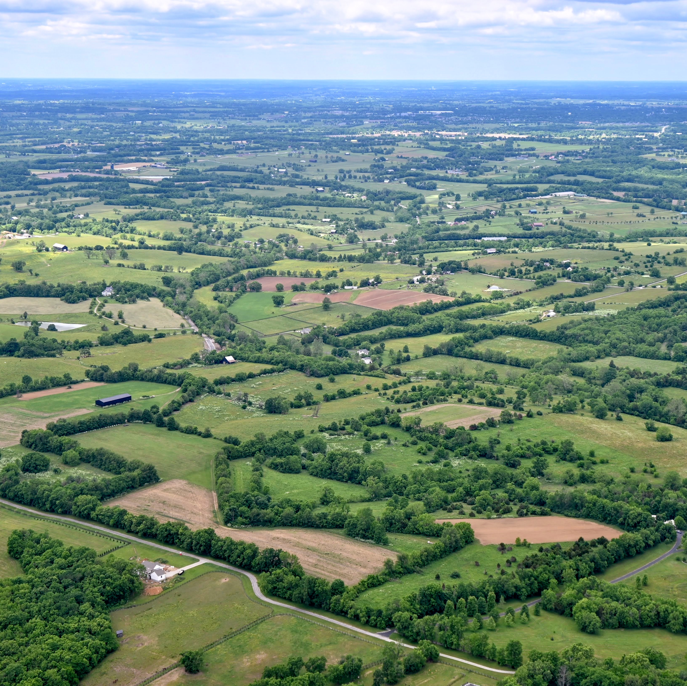
Informational Resources
National Extension Climate Initiative (NECI)
Neighborhoods at Risk
Census.gov Community Resilience

