Slide 1

Preparing the Public
Extension Resources
Kayla Watts
Specialized Agent for Community Recovery & Resiliency

Slide 2
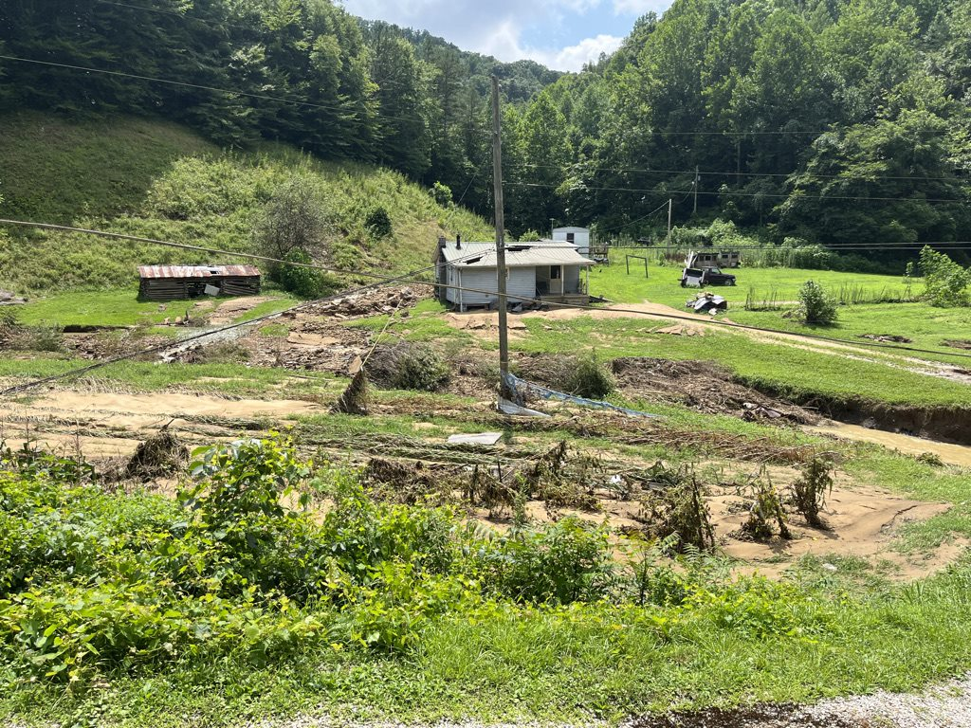
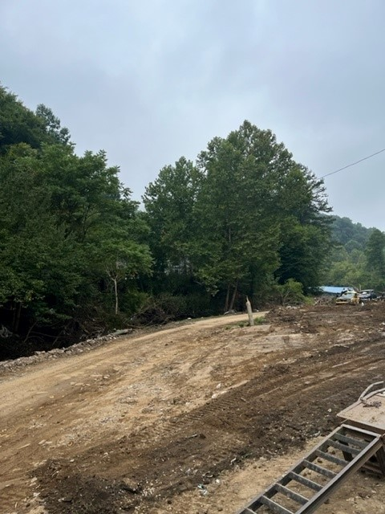
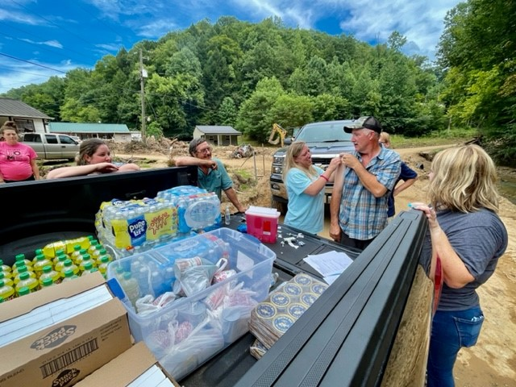
Experience
FCS Agent in Breathitt County
Home Community
Ice Storms, COVID, Major Floods
Notes:
I have 8 years of experience BUT have colleagues that had just started when the historic flooding took place
A lot to process and help with when you are a new or experienced employee.

Slide 3

Resources:
General
Notes:
All Program Areas

Slide 4
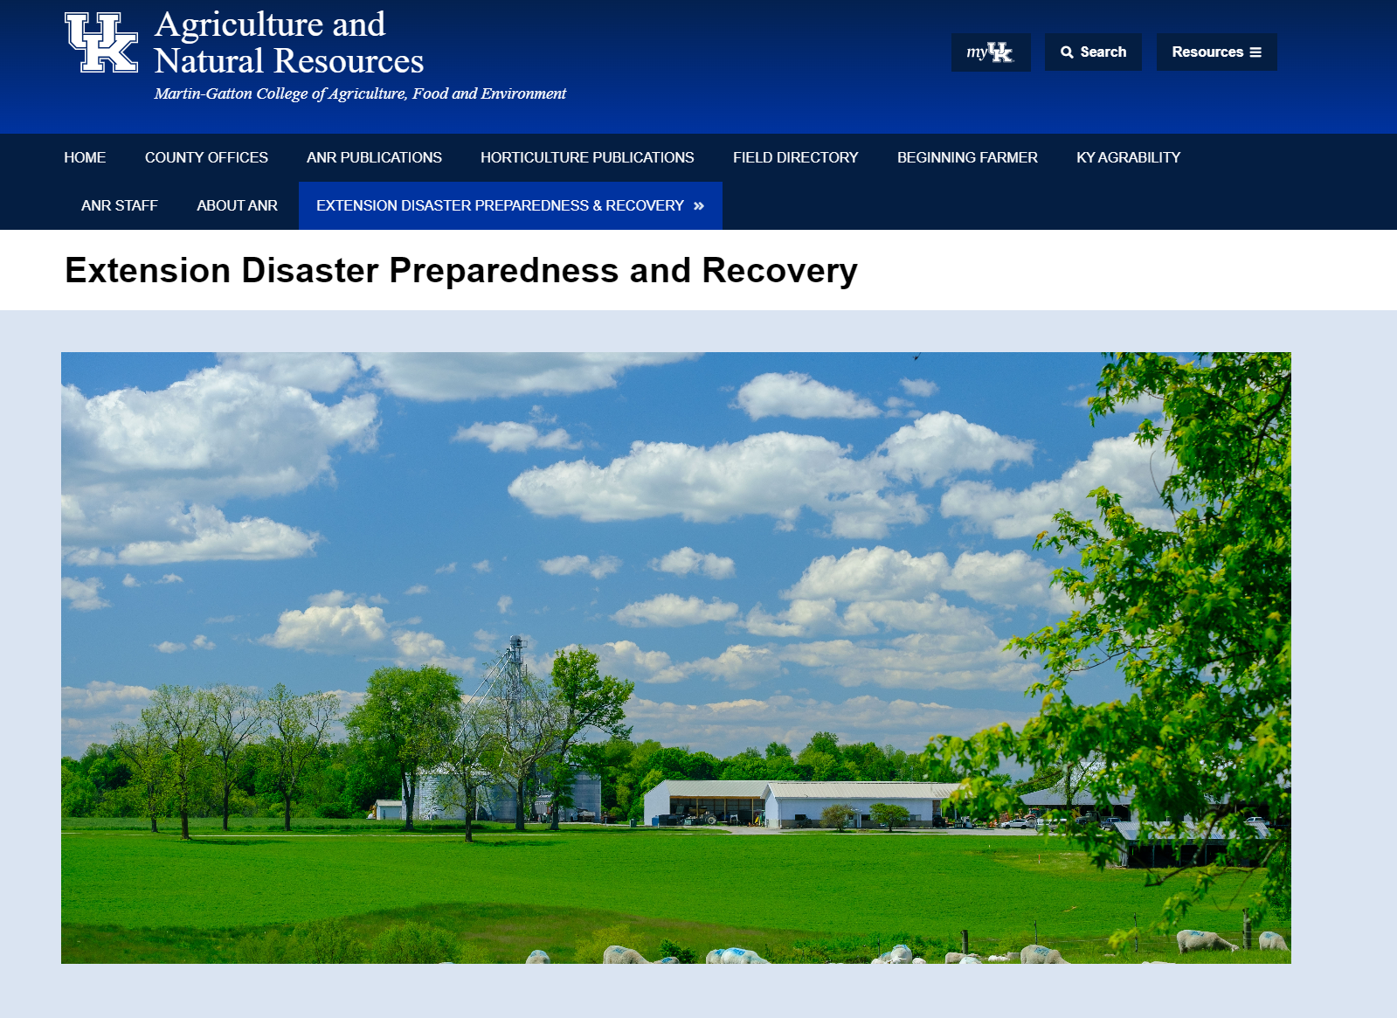
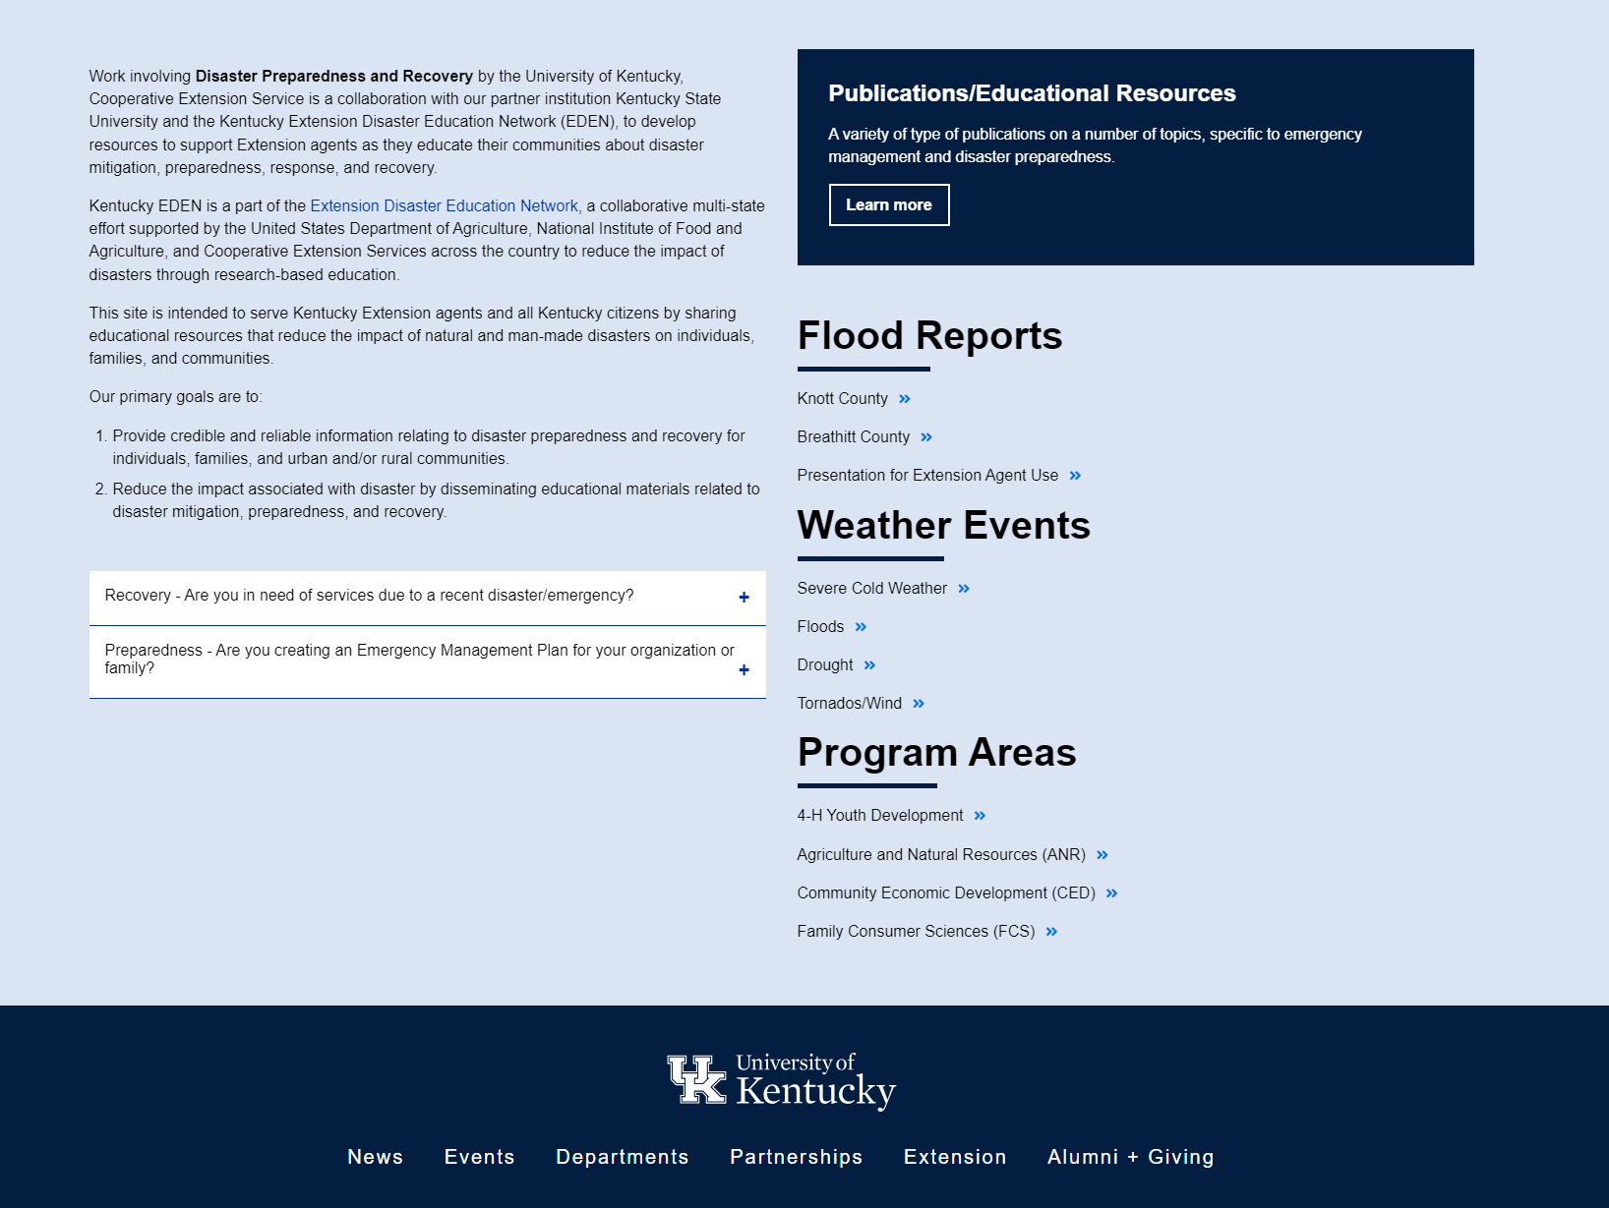
Resources
UK Extension Disaster Preparedness and
Recovery Website
https://anr.ca.uky.edu/extensionhelps
Notes:
Adding to this regularly
Data points as well as preparedness resources
Pulls from all sorts of sites/resources

Slide 5
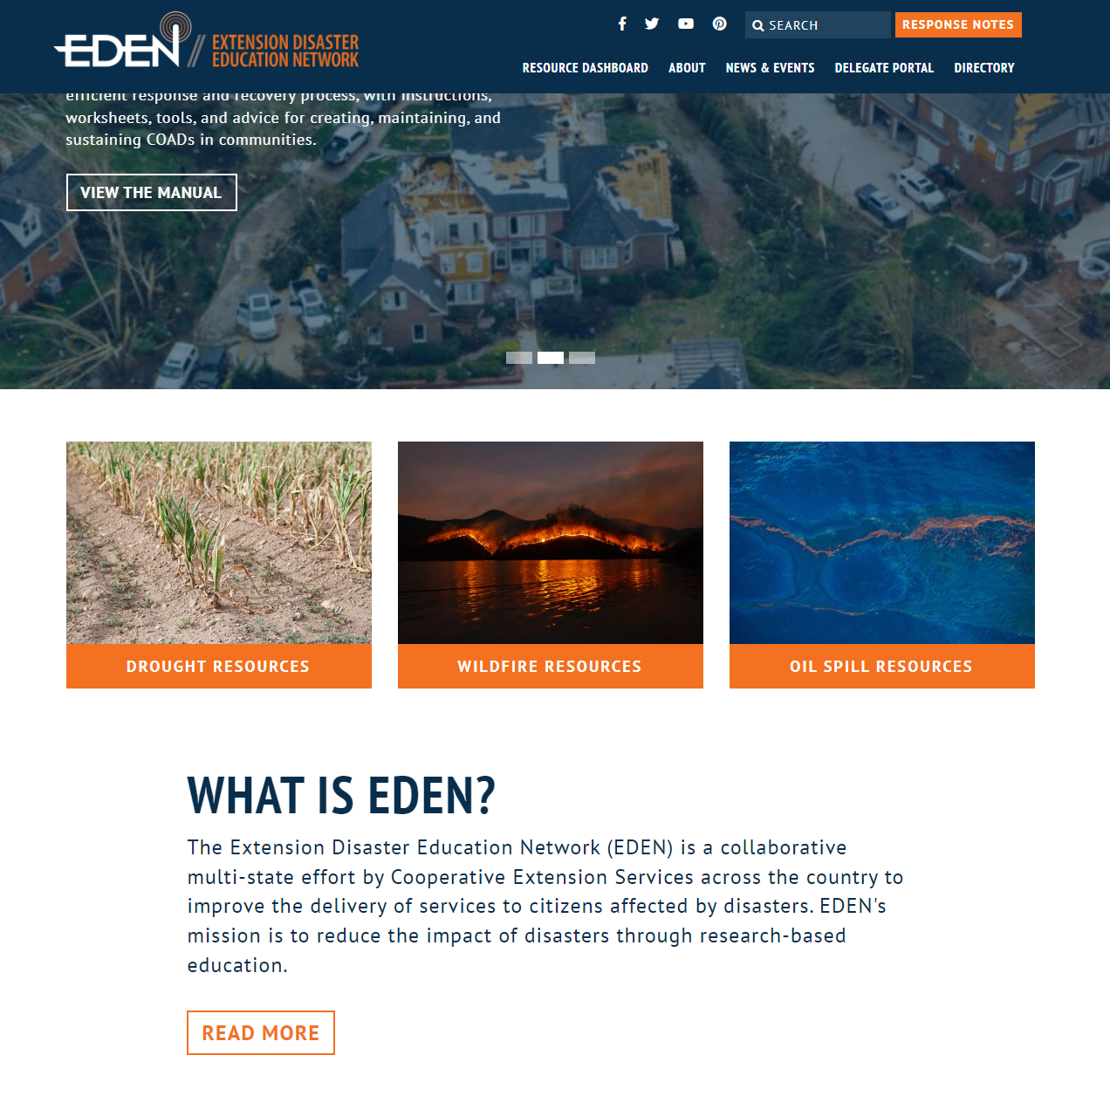
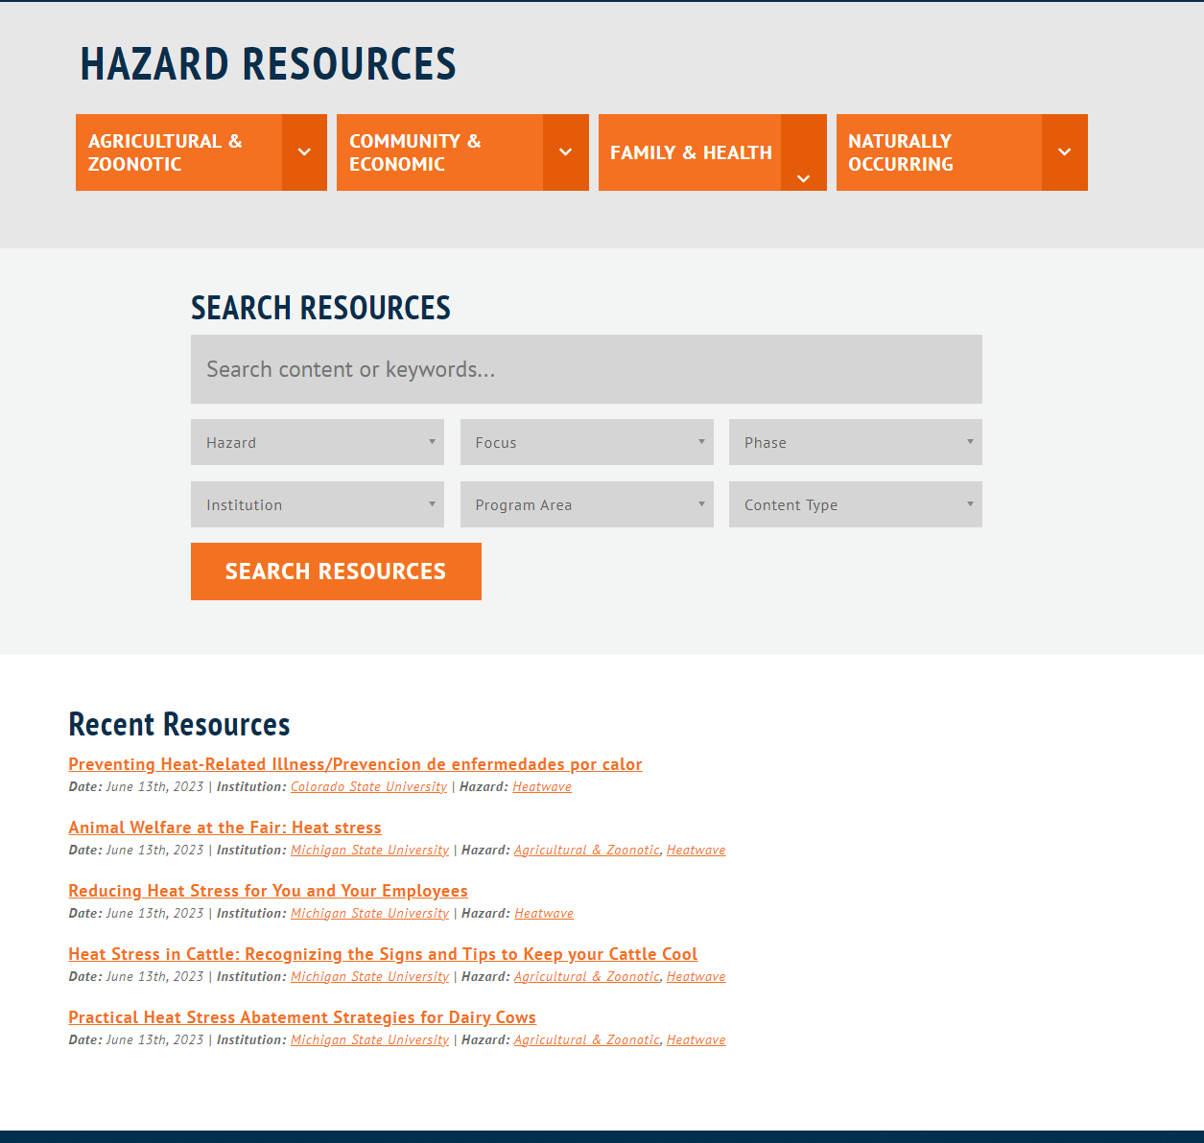
Resources
Extension Disaster Education Network (EDEN) Website
https://extensiondisaster.net/
Notes:
EDEN is the Extension Disaster Education Network
Collaboration of multi-state Extension leaders - Professors, specialists all the way to agents
Mission is to reduce the impact of disasters through research-based education
LOTS on the site
Offer regular webinars on various topics and programs/projects Check them out!

Slide 6
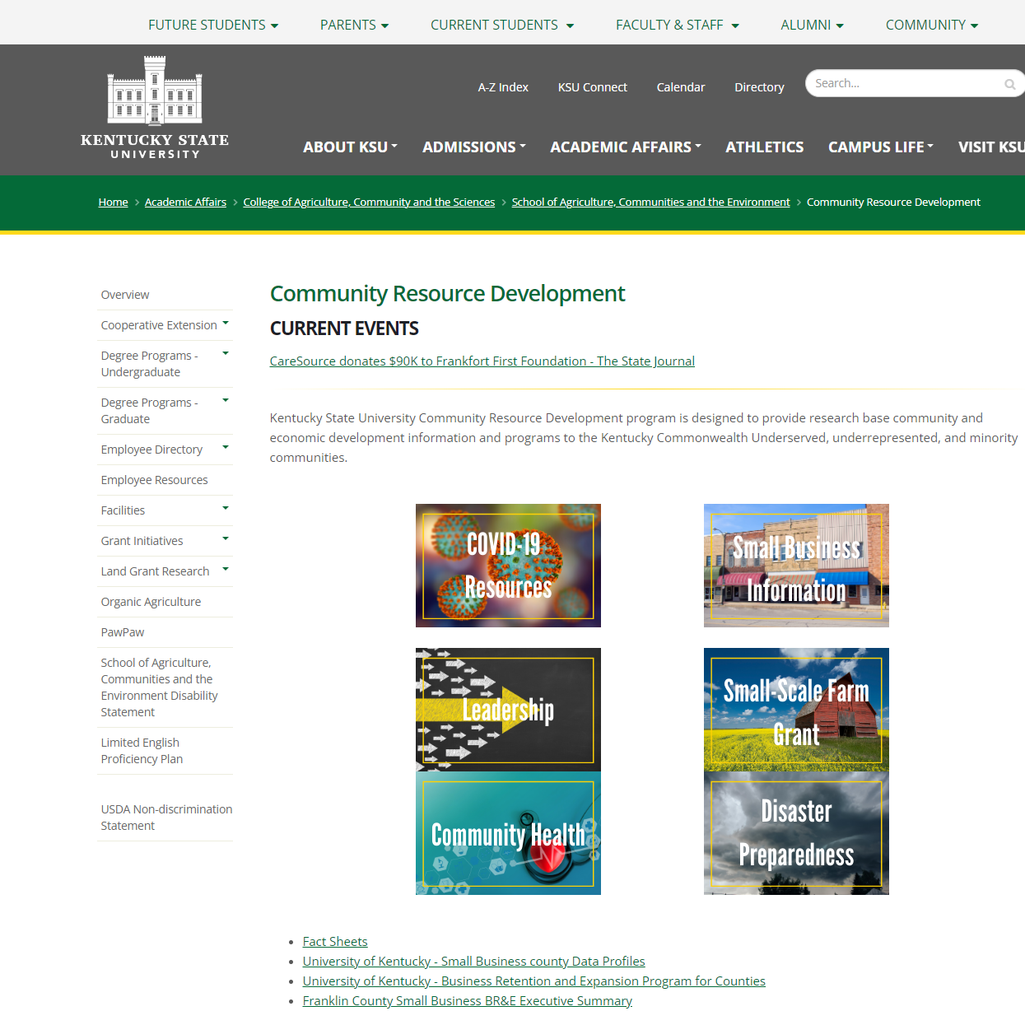
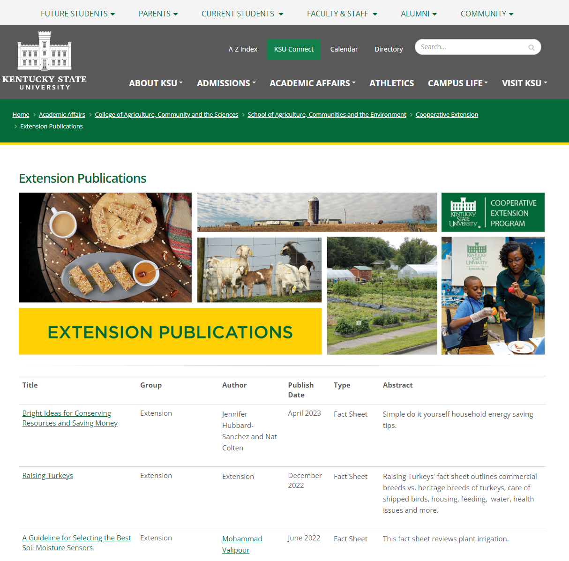
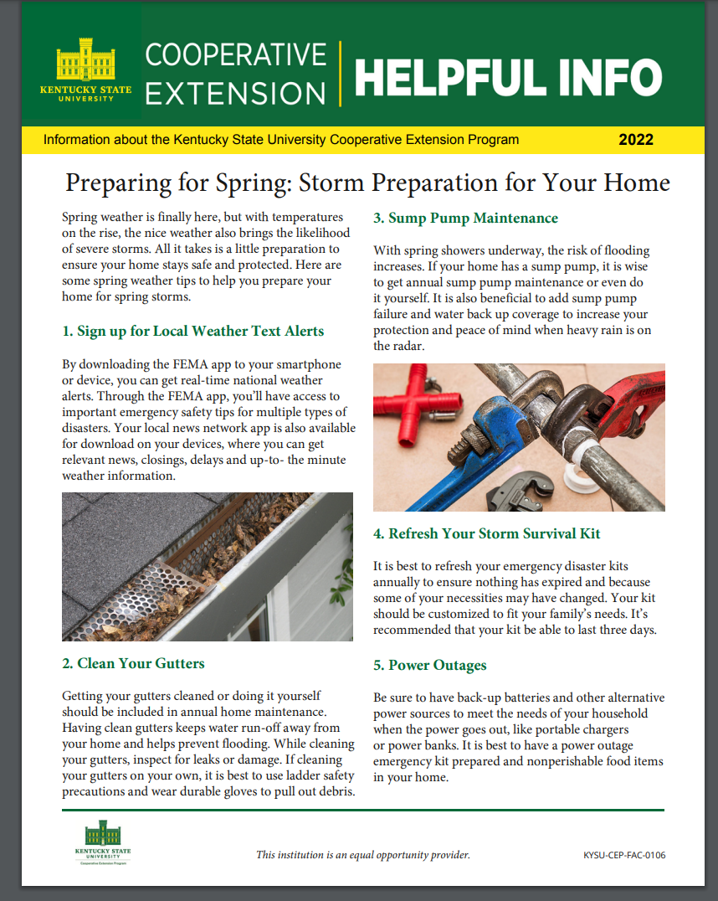
Resources
Kentucky State University
Community Resource Development
https://www.kysu.edu/academics/college- acs/school-of-ace/ace-com-res-dev/ace_community_resource_development.php
Notes:
Partners at KSU
Resources found on their Community Resource Development page – “FACTS SHEETS”
Publications - Example

Slide 7
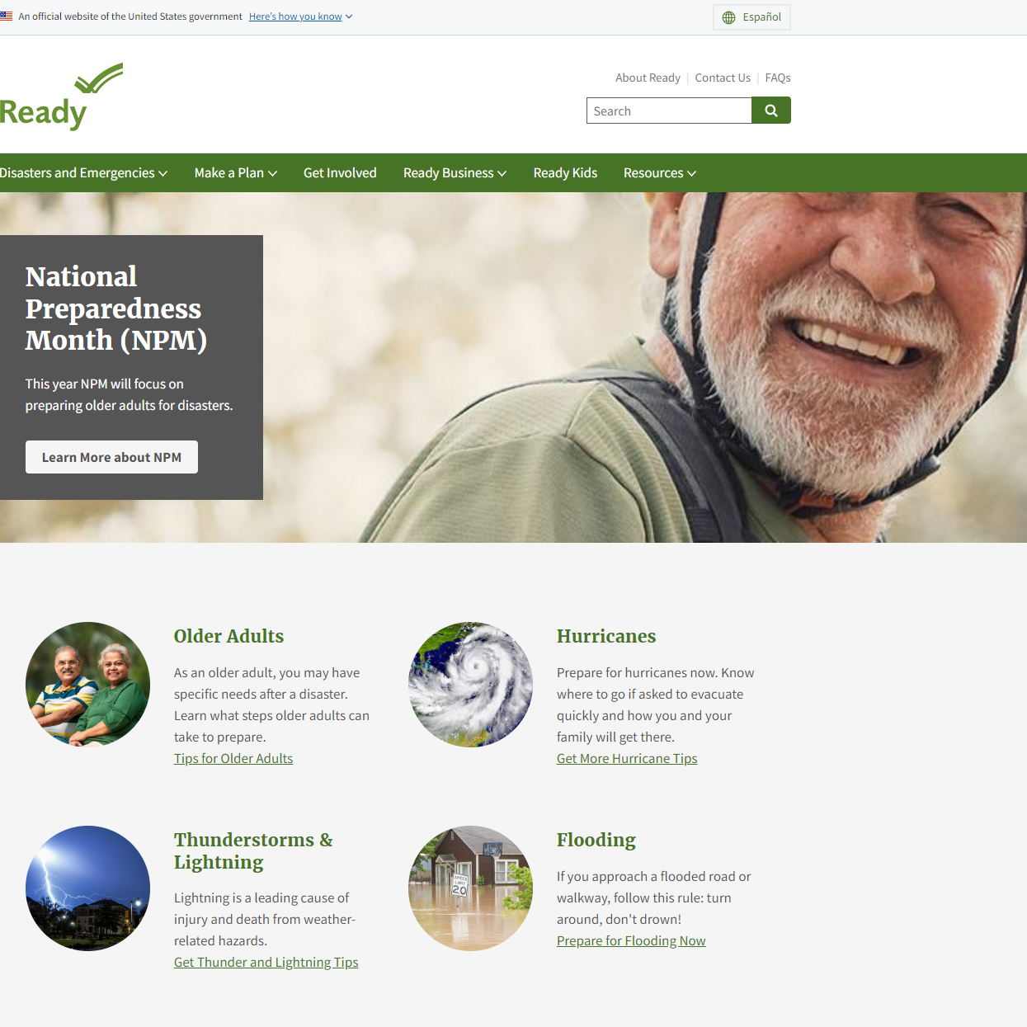
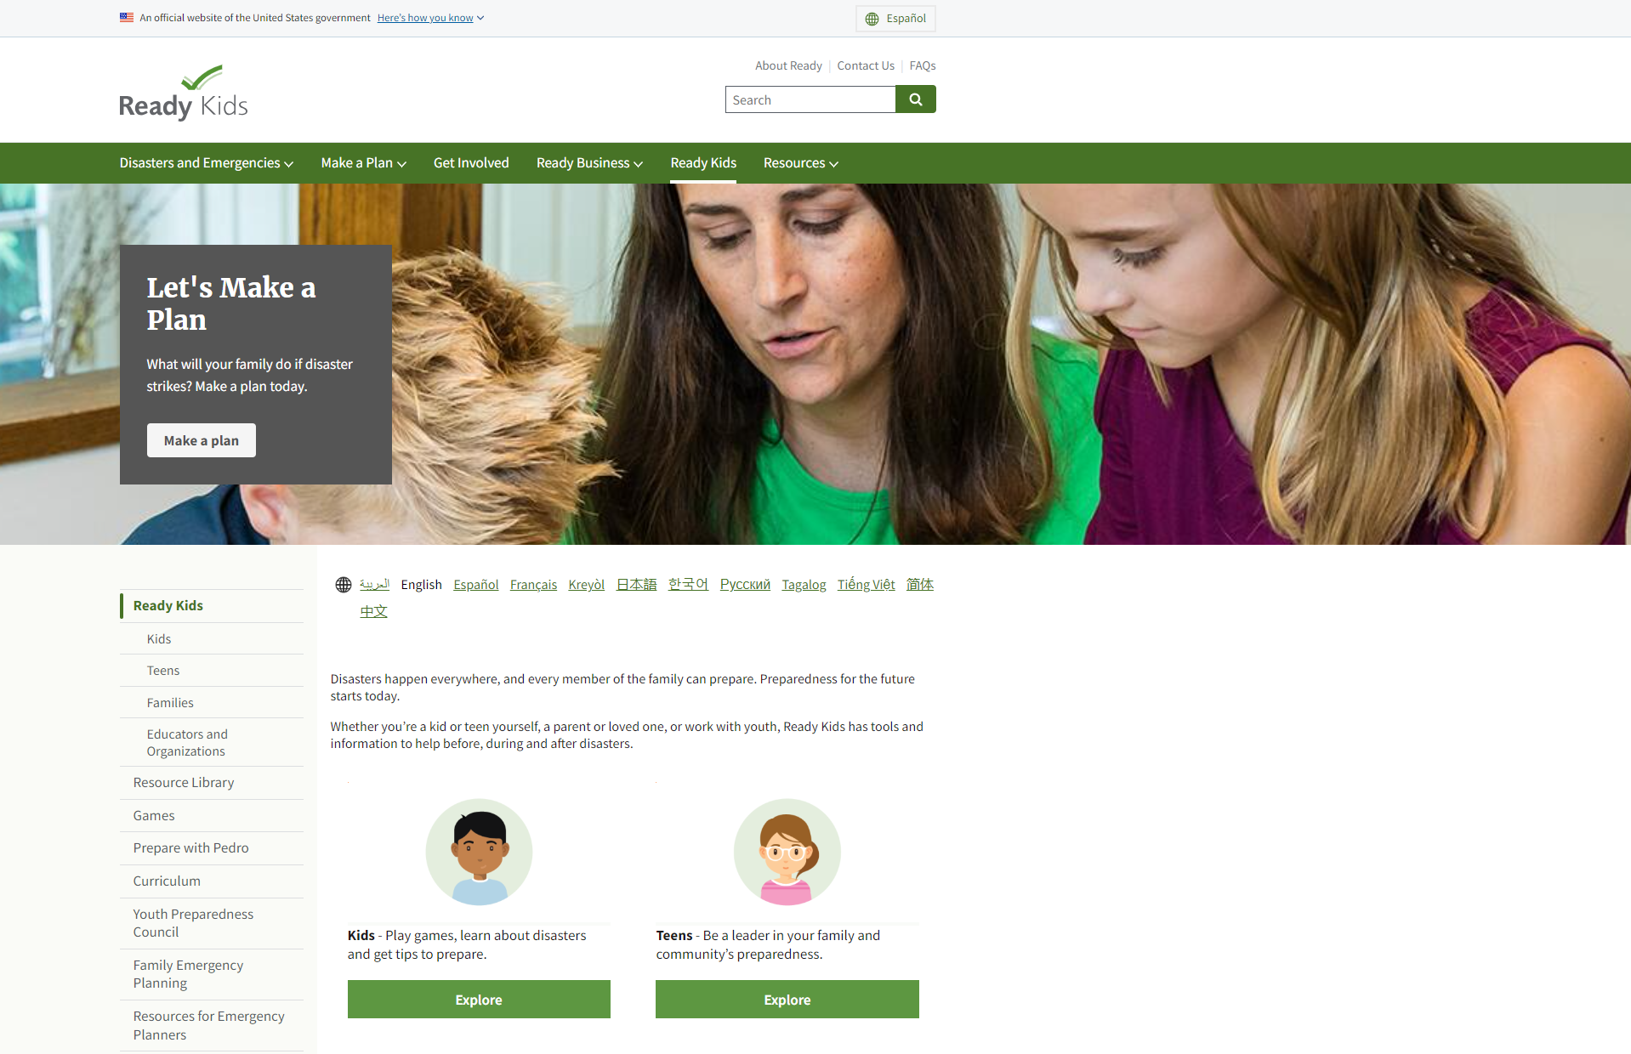
Resources
United States Disaster Readiness Site: https://www.ready.gov/
Notes:
Homeland Security’s - United States Government site devoted to Disaster Readiness
All sorts of resources for young and old
Lots of links from this site on other Extension Sites

Slide 8
Resources:
Program Specific

Slide 9
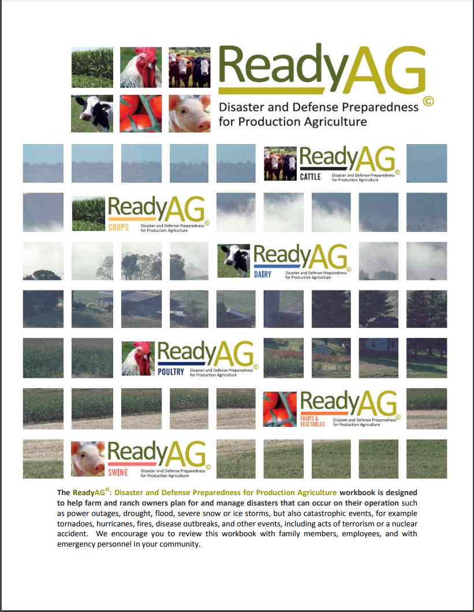
ANR Resources
ReadyAG© Workbook https://extension.psu.edu/readyag-workbook
Penn State & USDA
Linked on EDEN website
Notes:
LOVE this resource
Over 60 pages in length
General farmer in front – broken out by specifics in other sections
Great for use with Beginner Farmers – Example of mail box letters!
Has a checksheet for farmers/ranchers
Can be applied to small or large scale

Slide 10
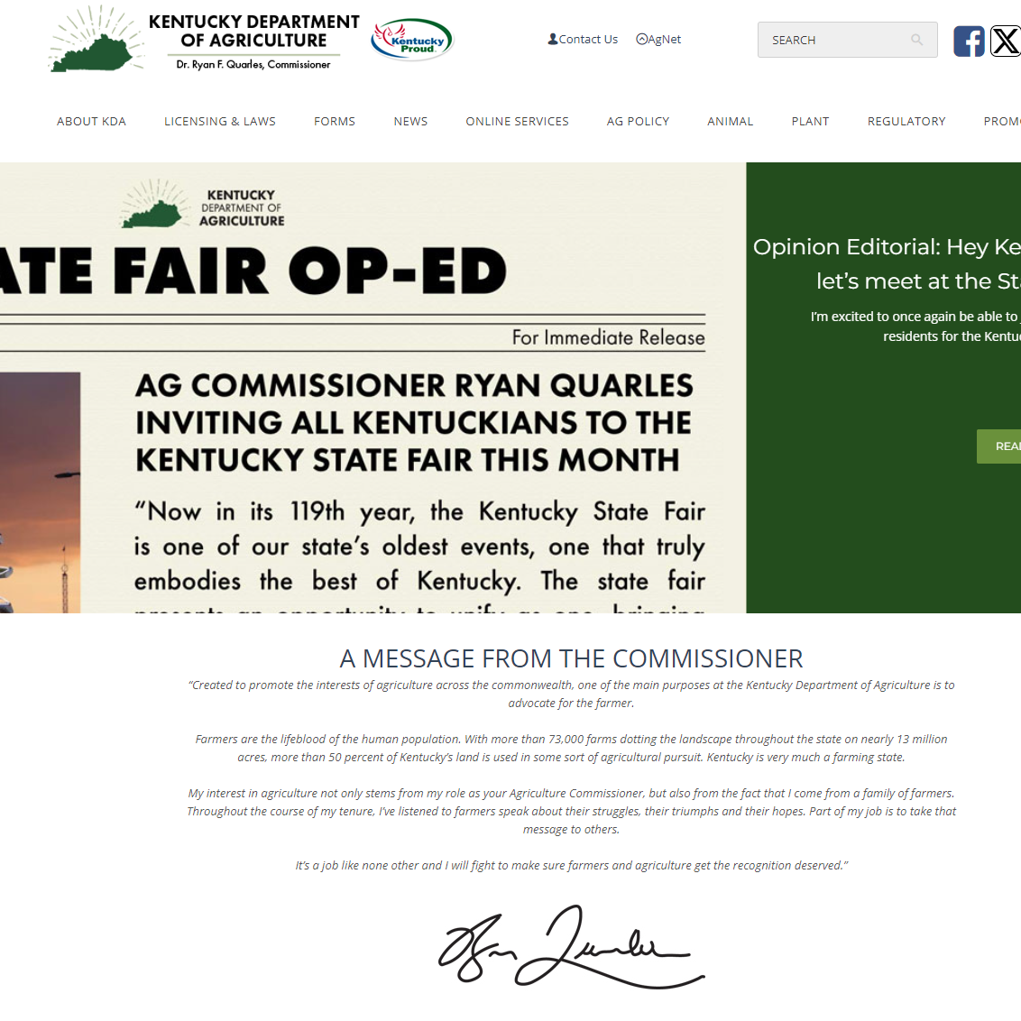
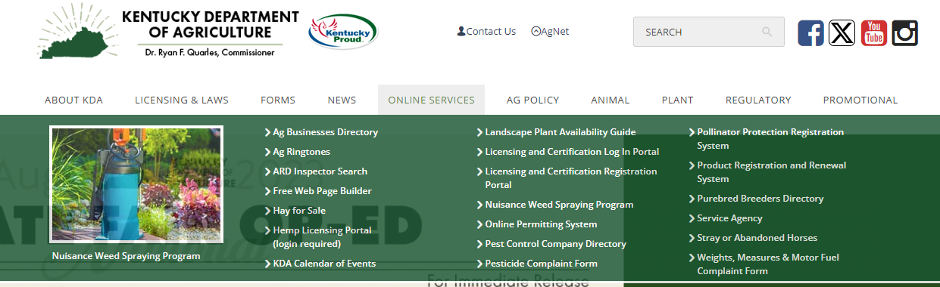
ANR Resources
Kentucky Department of Agriculture
https://www.kyagr.com/
Notes:
Regularly updated on policies and procedures for new and existing farmers.
Would be good to check routinely for changes
Will post information about relief programs on this site

Slide 11
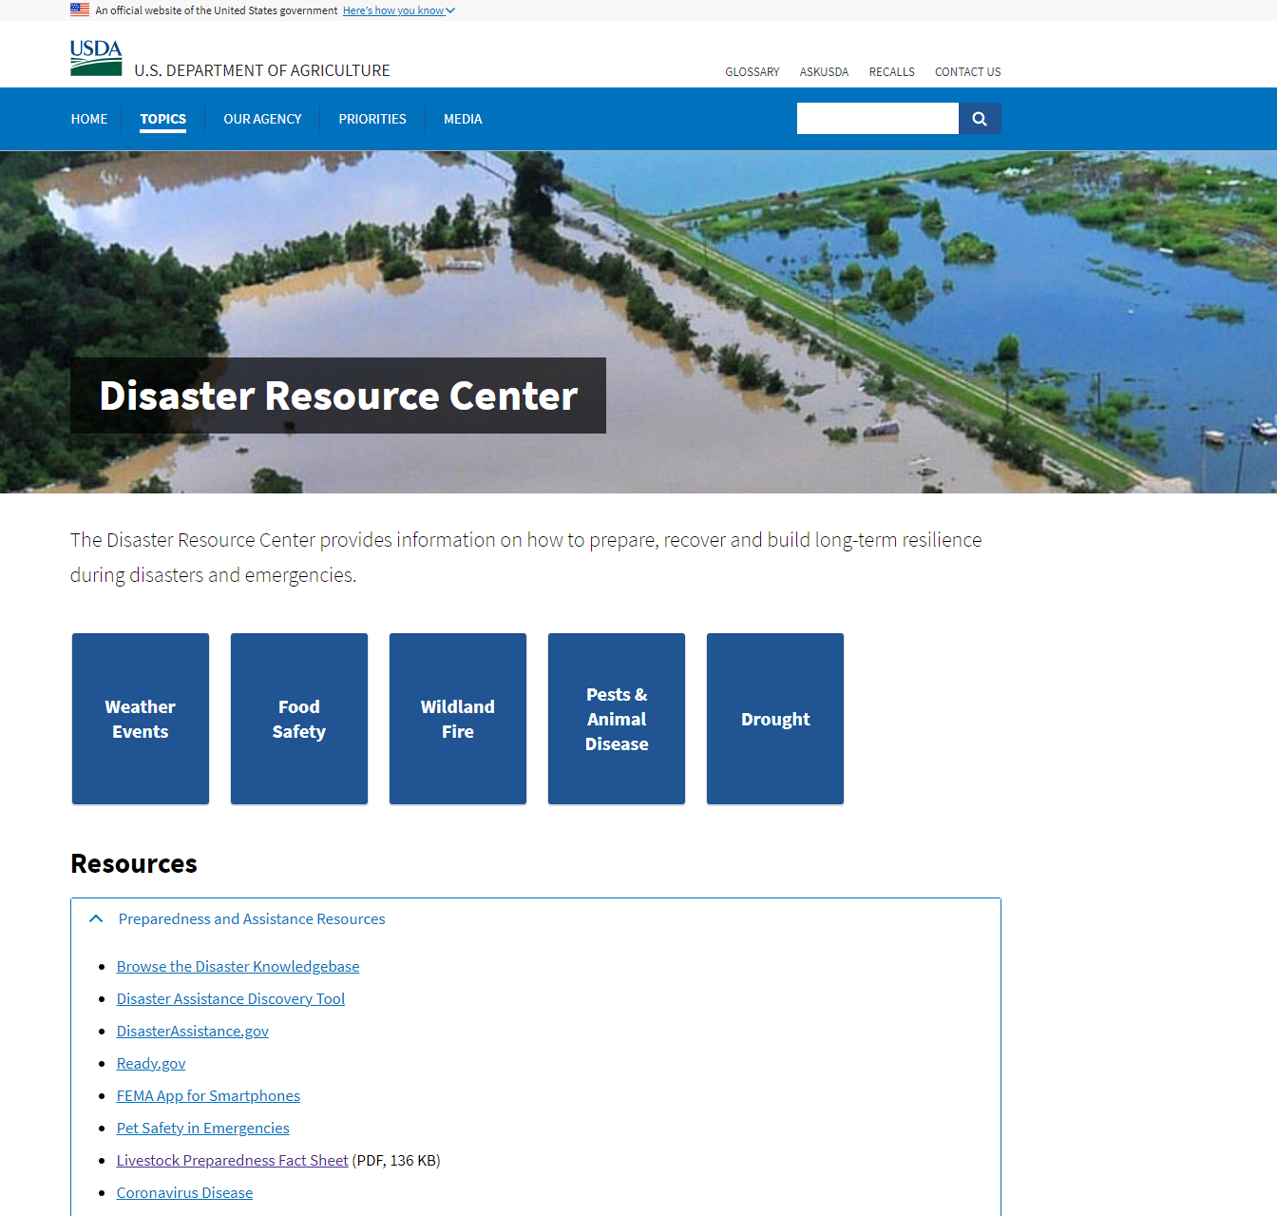
ANR Resources
USDA Farm Service Agency (FSA) Disaster Resource Center: https://www.usda.gov/topics/disaster-resource-center
Notes:
USDA official Disaster Site
Lots of good resources
Connect with local agent

Slide 12

ANR Resources
Kentucky Fish and Wildlife Education Resources https://fw.ky.gov/Education/Pages/default.aspx
Notes:
Think about Wildlife
They will appear in unusual places after a disaster
Help farmers and home owners prepare ahead of time
Beavers example
Dead animals/removal/policies example

Slide 13

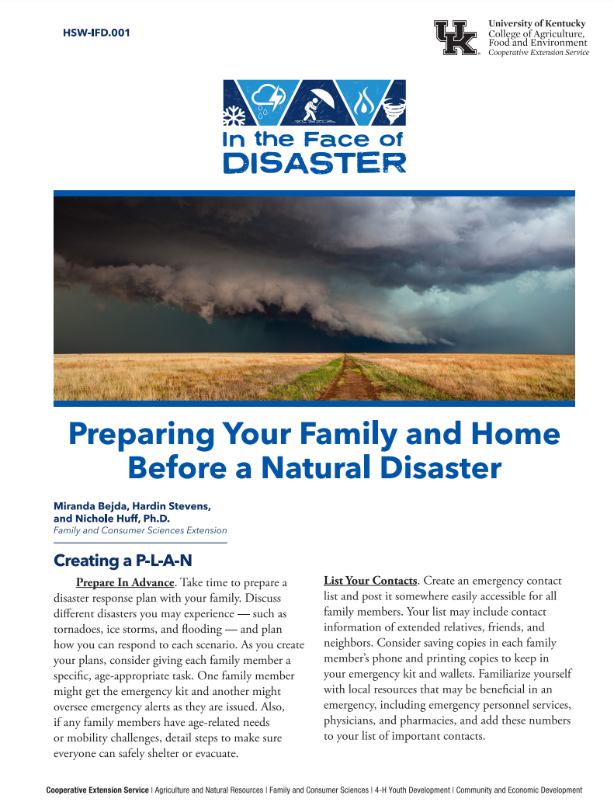
FCS Resources
In the Face of Disaster Toolkit
*New lesson added
Notes:
New curriculum/Toolkit
Adding to it regularly – Trauma After a Disaster just added – great lesson for any sort of trauma – Non-invasive
DISASTER KIT FOR YOUR OFFICE!!!
Wonderful pyblications/advertisements and anything you need to do lessons or set up at fairs to give resources

Slide 14
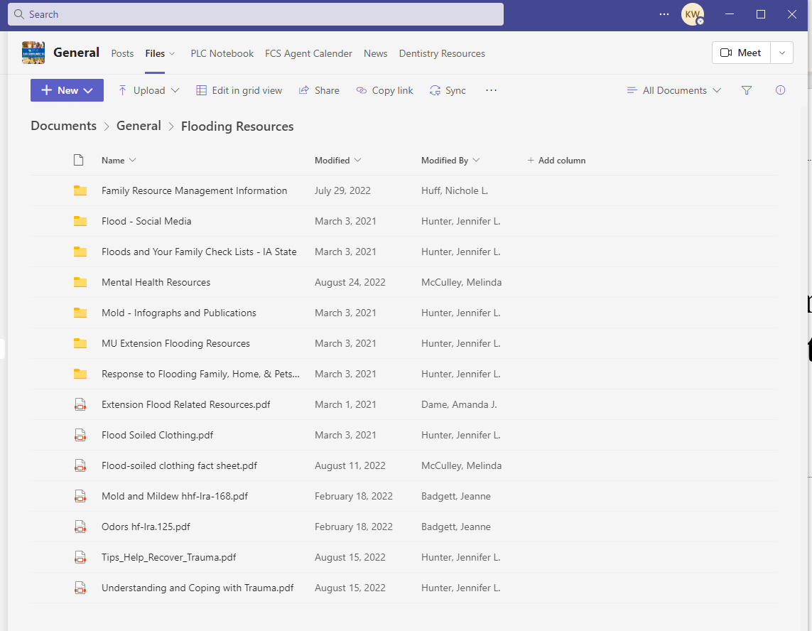
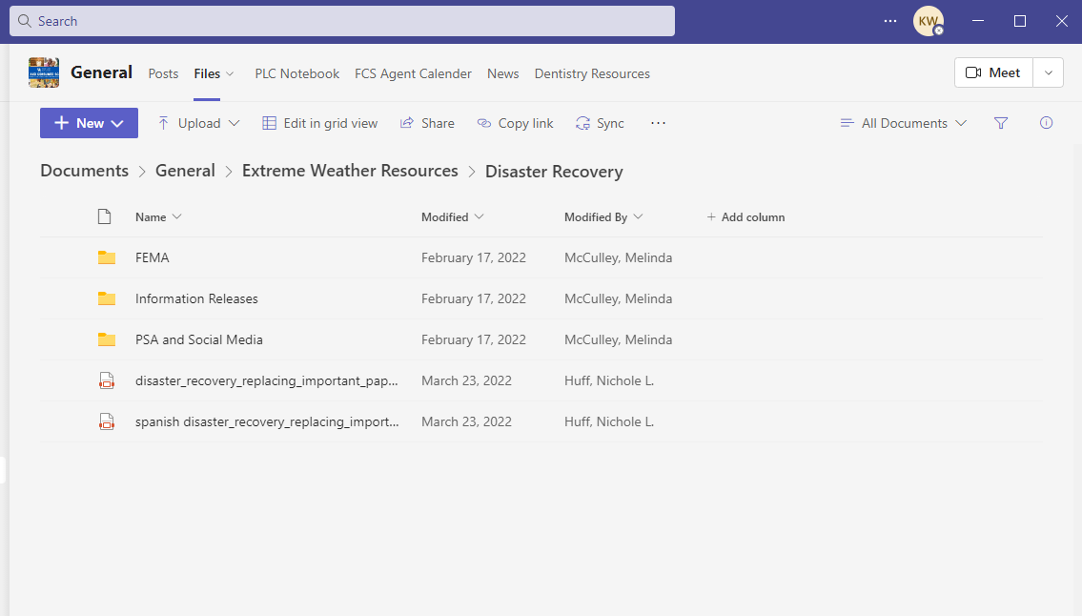
FCS Resources
FCS Agent TEAMS Page
Notes:
TEAMS page has lots of information
Go over Documents- General – Flooding OR Documents – General – Extreme Weather – Disaster Recovery
Don’t be afraid to “drill down” to find useable information

Slide 15
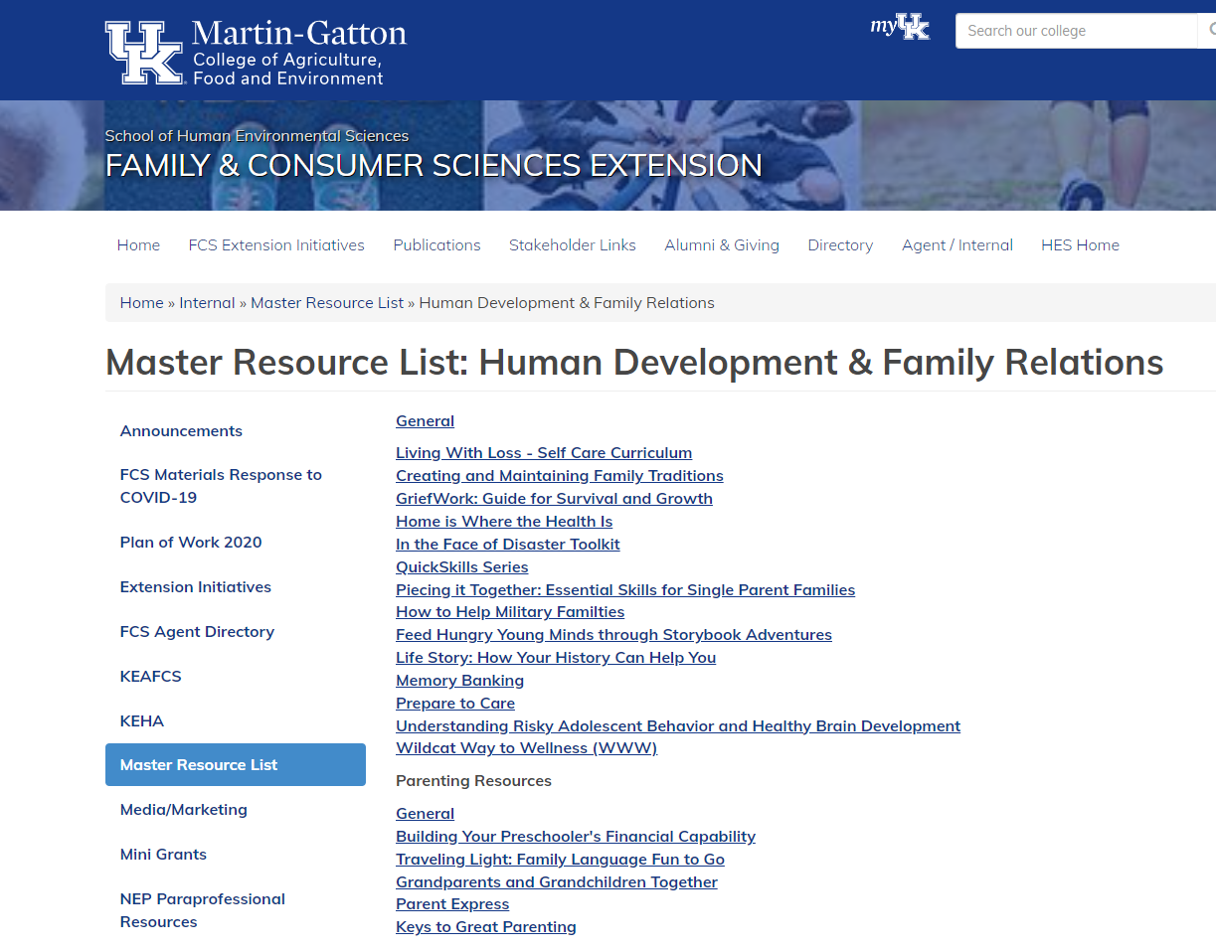
FCS Resources
FCS Agent Internal Resources
Human Development & Family Relations
Family Resource Management
Notes:
Master Resource List has things that do apply before and after disasters
Particularly in the Human Development and Family Relations programs – Also Family Resource Management
Credit and Farm/Estate planning are always good to have in order prior to a disaster

Slide 16

4-H Youth Development
Resources
Youth Strong: Helping Youth and Families in Times of Disaster and Stress (2023)
Notes:
Youth Strong: Helping Youth and Families in Times of Disaster and Stress (2023)
*This guide was written and designed for Kentucky Cooperative Extension Professionals to use. We have dates scheduled on KERS for 90-minute learning sessions on how to use the materials. Each participant will receive 25 copies of the guide for attending. Additional copies may be purchased for $2 per copy.
Your Thoughts Matter: Navigating Mental Health (2019)
*This facilitator guide was developed for Club Leaders, Mentors, or Coaches to use when working with teenagers. It can be purchased on the National 4-H website.
Your Feelings Matter: Navigating Mental Health (2019)
*This facilitator guide was developed for Club Leaders, Mentors, or Coaches to use when working with younger youth. It can be purchased on the National 4-H website.
Kentucky 4-H: Programming in Times of Crisis (2020)
*This guide, adapted from Louisiana 4-H YD, shows ways 4-H Programming can be facilitated after a crisis.
Coming in mid-September​​
*Additional digital resources on the new 4-H Teams page.
Please let me know how I can assist more!
Chuck

Slide 17

4-H Youth Development
Resources
Your Thoughts Matter: Navigating Mental Health (2019)
Your Feelings Matter: Navigating Mental Health (2019)

Slide 18

4-H Youth Development
Resources
Kentucky 4-H: Programming in Times of Crisis (2020)

Slide 19
4-H Youth Development
Resources
Coming in Mid-September​​
Additional digital resources on the new
4-H Teams page
Charles E. Stamper, Ed.D.
Extension Special Projects Coordinator
4-H Youth Development
University of Kentucky Cooperative Extension Service
130 Robinson Road
Jackson, KY 41339
O: 606.666.2438 x237
C: 859.351.7510
cstamper@uky.edu

Slide 20
Questions?
Thank you for your time!

Slide 21


